Slide 1
HL7 Payer Summit What is FHIR?
Lloyd McKenzie
Sept 19, 2014

Slide 2
This presentation
Can be downloaded here:
http://gforge.hl7.org/svn/fhir/trunk/presentations/2014-09 Tutorials/FHIR for Payers 1.pptx
Use “anonymous” and email address to logon
Is licensed for use under the Creative Commons, specifically:
Creative Commons Attribution 3.0 Un-ported License
(Do with it as you wish, so long as you give credit)

Slide 3

Who am I?
Name: Lloyd McKenzie
Company: Gordon Point Informatics (GPi)
Background:
One of FHIR’s 3 principle editors
Co-chair FHIR Management Group
Co-chair HL7 Modeling & Methodology
Chair HL7 Canada Architecture & Infrastructure
Heavily involved in HL7 and healthcare exchange for last 15 years (v2, v3, CDA, etc.)

Slide 4
Content
Brief Introduction to FHIR
Timeline, status & who’s using it
Where FHIR may fit for claims-related exchange

Slide 5
The acronym
F – Fast (to design & to implement)
Relative – No technology can make integration as fast as we’d like
H – Health
That’s why we’re here
I – Interoperable
Ditto
R – Resources
Building blocks – more on these to follow
Notes:
9:25

Slide 6
FHIR Manifesto
Focus on Implementers
Leverage cross-industry web technologies
Target support for common scenarios
Require human readability as base level of interoperability
Support multiple paradigms & architectures
Make content freely available
Demonstrate best practice governance
Notes:
Implementers: Focus is those who write code, reference implementations & test servers, APIs in 5 languages, connectathons, readable instances, instance examples, focus on “what do systems do now?”
Web technologies: XML, JSON, Use REST calls similar to Google, Amazon, leverage HTTPS, OAuth other industry technologies
Common Scenarios: 80%, us of extensions
Human readability: like CDA, but everywhere
Paradigms: REST, Documents, Messages, Services – all use same structure & templates
Free: No IP barriers to use

Slide 7


Resources
“Resources” are:
Small logically discrete units of exchange
Defined behaviour and meaning
Known identity / location
Smallest unit of transaction
“of interest” to healthcare
V2: Sort of like Segments
V3: Sort of like CMETs

Slide 8
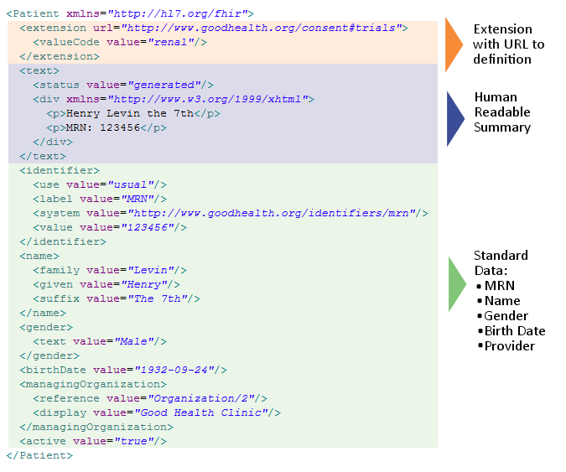
Notes:
System for gender is wrong . . .

Slide 9
It’s all about the resources . . .
Location
Lab
Report
Related
Person
Patient
Practitioner

Slide 10
What’s a Resource?
Examples
Administrative
Patient, Practitioner, Organization, Location, Coverage, Invoice
Clinical Concepts
Allergy, Condition, Family History, Care Plan
Infrastructure
Composition, Message, Profile, Conformance
100-150
Total
(ever)
Notes:
And few systems will ever see more than 40-50

Slide 11
Who’s using FHIR now?
Other SDOs (IHE, DICOM)
Government organizations (ONC, NHS)
Care delivery organizations (Kaiser, Regenstrief, Intermountain, etc.)
Vendors (Cerner, Epic, etc.)
Small start-ups
All over the world
Notes:
Some doing experimentation, others working toward full production or already there.

Slide 12
FHIR Timeline
Currently Draft Standard for Trial Use
No commitment to inter-version compatibility (yet)
Second DSTU version to be published Summer, 2015
Time for early adoption/experimentation/adjustment
Normative
Likely published in 2017
Notes:
Even though FHIR is not fully baked, lots of implementers are rolling out production code based on FHIR now.

Slide 13
FHIR for Payers
Opens up the possibility of REST-based claims processing
Mobile-friendly
May provide an easier platform for designing claims attachments
Easy to extend resources to have additional content specific to certain payers
Questionnaire and Profile may be useful in guiding data capture
Notes:
Phone-based apps to access coverage info, request coverage extensions

Slide 14
FHIR
http://hl7.org/fhir
Twitter: #FHIR
Me: lloyd@lmckenzie.com
Notes:
We don’t actually have a formal manifesto, but these are the principles we adhere to.

